Slide 1
Modelling for Categories Weighting attention an Extended Exemplar Approach VS. Neural Network
By: Lama Alsmmahi

Slide 2
Working Memory and Long-Term Memory
Memory & Attention.
Memory span Tests (simple span task such as, word span and digit span and complex span tasks like reading span test and operation span).
Serial Position Effect.
(Baddeley and Working Memory Span Measures 3 Hitch 1974; Daneman and Carpenter 1980; Baddeley 1986; Miller et al. 1960; Miyake and Shah 1999).

Slide 3
Exemplar theory
Exemplar is a theory which addresses how humans categorize objects in their minds, where they categorize by comparing new stimuli with previous examples already stored in memory. Each example stored in memory is called the “Exemplar".

Slide 4
Exemplar theory
There were various experimental studies results who preferred exemplar models (Medin & Schaffer, 1978; Medin & Smith, 1981; Medin et al., 1982; Nosofsky, 1992).
Rosch (1975) reported that researches criticised exemplar models for being ineffective and biologically not acceptable. They claim that it would be difficult to imagine people storing in memory all previous examples and using all of them in comparing when categorizing a new stimuli.
Briscoe & Feldman (2011) stated that we should consider data complexity. They believe that humans control their complex mental representation to match the category structure type. So, humans don’t present a prefect training instead they emphasise on generalisation accuracy.
Smith (2014) also supported the concept of analysing category representations in terms of generalisation accuracy, as it’s the backbone for the survival in further researches.
Reference:
Zubek, Julian & Kuncheva, Ludmila. (2018). Learning from Exemplars and Prototypes in Machine Learning and Psychology.

Slide 5
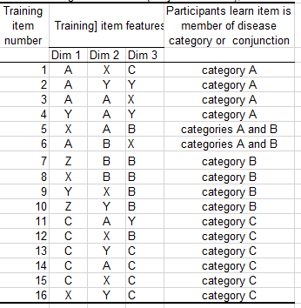
The ATTENTION & memory effect
MORE ATTENTION 45% - 50%
LESS ATTENTION 20%
LESS ATTENTION 35%

Slide 6
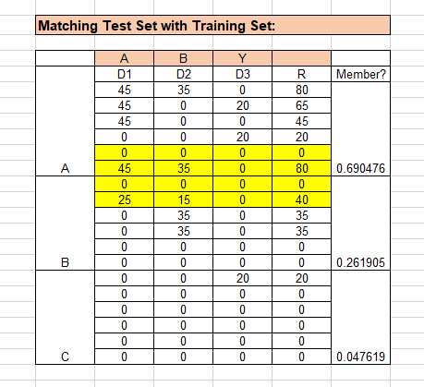
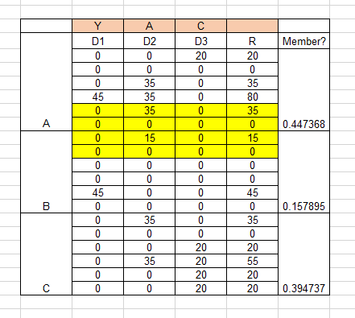
One Category
5 | X | A | B | categories A and B
6 | A | B | X | categories A and B
=SUM(R(A)/
SUM(R(A+B+C)
=SUM(D1+D2+D3)

Slide 7
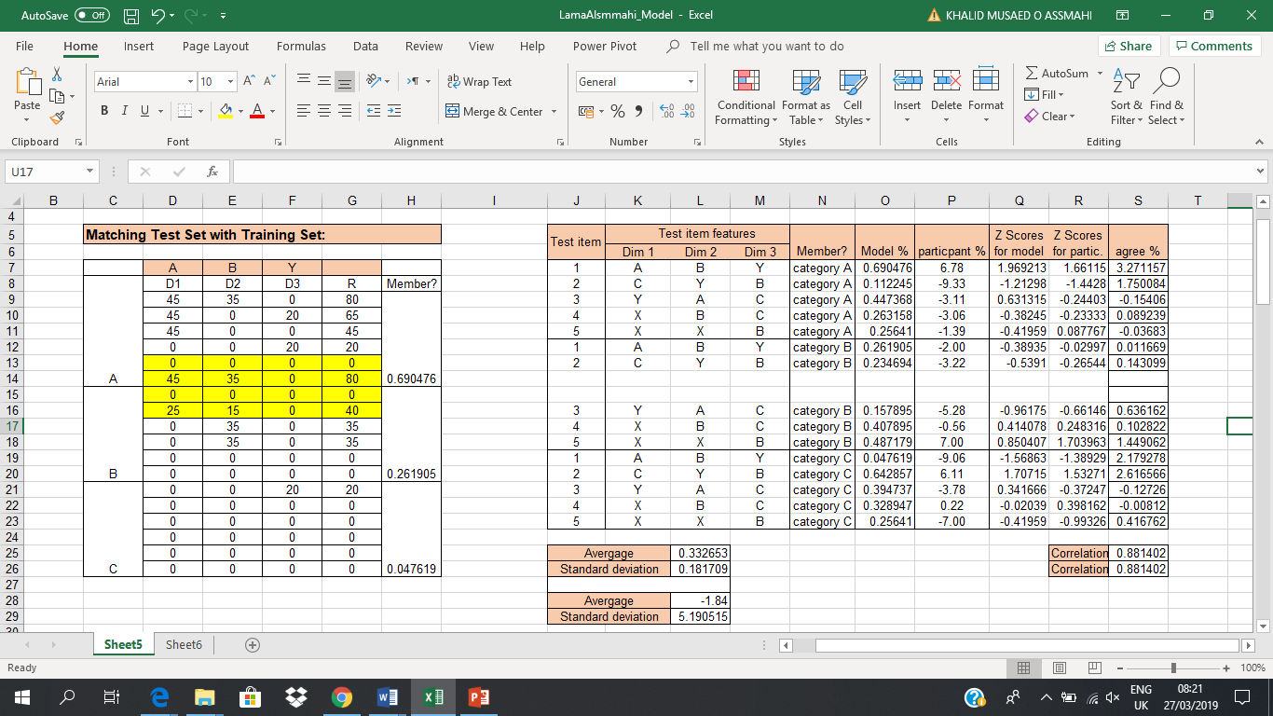
One Category

Slide 8
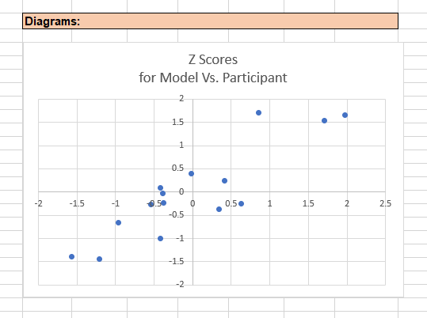
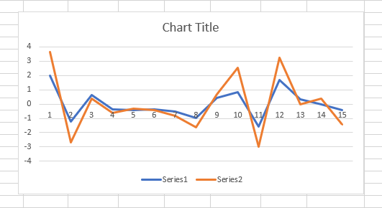
One Category

Slide 9
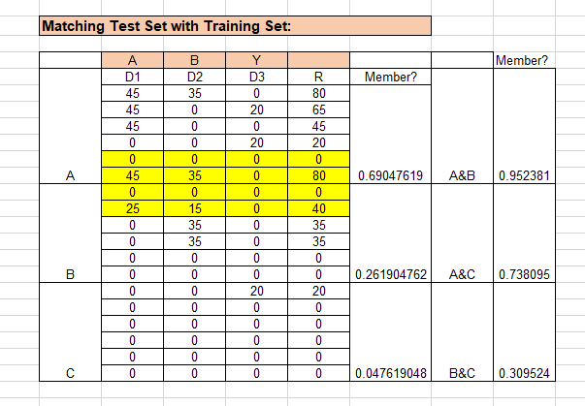
Two categories
=SUM(Member (A+C)

Slide 10
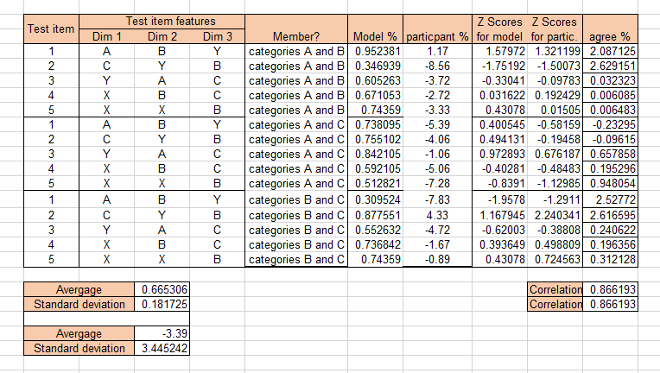
Two categories

Slide 11
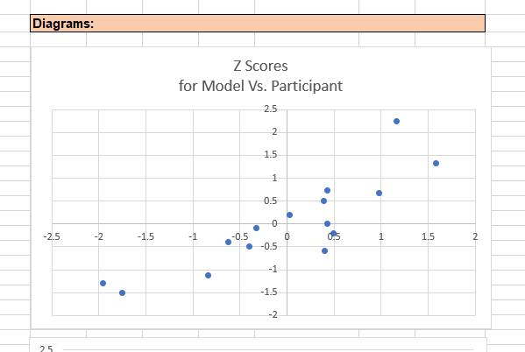
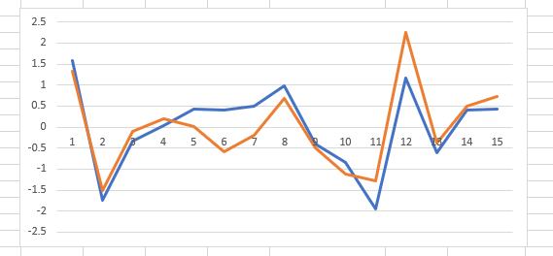
Two categories

Slide 12
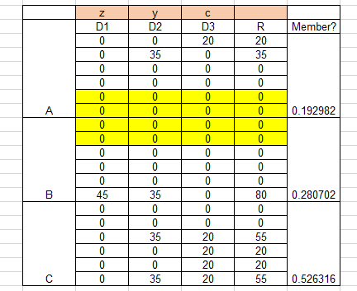
A failure in Models
Is getting a good correlation everything?

Slide 13
Neural Network
What is a Neural Network?
Stergiou and Siganos described the NN as:
An Artificial Neural Network (ANN) is an information processing paradigm that is inspired by the way biological nervous systems, such as the brain, process information.
The key element of this paradigm is the novel structure of the information processing system. It is composed of a large number of highly interconnected processing elements (neurones) working in unison to solve specific problems. ANNs, like people, learn by example. An ANN is configured for a specific application, such as pattern recognition or data classification, through a learning process.
Reference:
C., Stergiou, & D., Siganos. (n.d.). Neural Networks(Rep.). Retrieved from https://www.doc.ic.ac.uk/~nd/surprise_96/journal/vol4/cs11/report.html

Slide 14
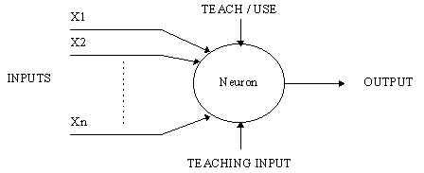
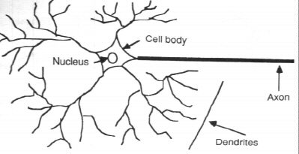
A simple neuron
Reference:
C., Stergiou, & D., Siganos. (n.d.). Neural Networks(Rep.). Retrieved from https://www.doc.ic.ac.uk/~nd/surprise_96/journal/vol4/cs11/report.html

Slide 15
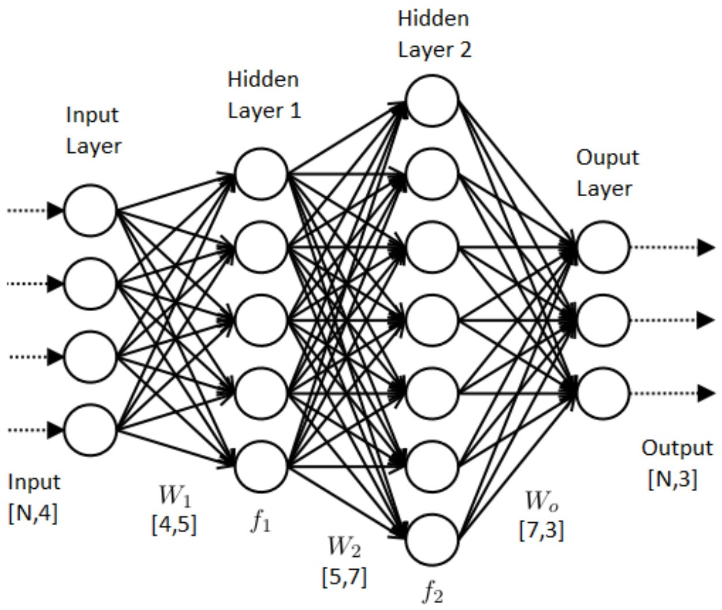
A more complicated neuron
Stergiou and Siganos said:
A neural network is made up of neurons connected to each other; at the same time, each connection of our neural network is associated with a weight that dictates the importance of this relationship in the neuron when multiplied by the input value.
Each neuron has an activation function that defines the output of the neuron. The activation function is used to introduce non-linearity in the modelling capabilities of the network. In this model I used the sigmoid.
Reference:
C., Stergiou, & D., Siganos. (n.d.). Neural Networks(Rep.). Retrieved from https://www.doc.ic.ac.uk/~nd/surprise_96/journal/vol4/cs11/report.html

Slide 16
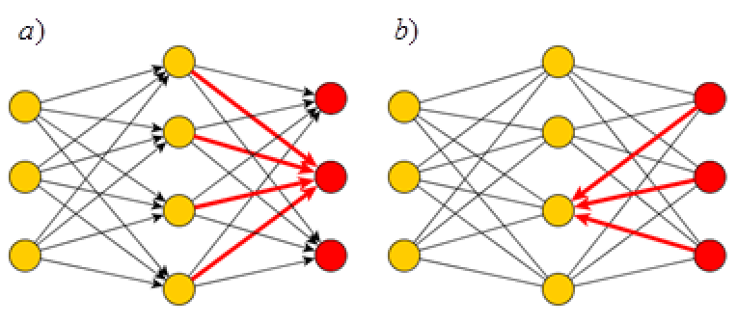
Training The neural network
Torres (2018) described the process as the following:
learning the values of our parameters (weights wij and bj biases). (Randomly set automatically by libraries, practically these are random numbers from -0.2 to 0.2). learning process: an iterative process of “going and return” by the layers of neurons. (Forward-propagation & back-propagation).
A) The first phase forward-propagation occurs when the network is exposed to the training data and these cross the entire neural network for their predictions (labels) to be calculated.
That is, passing the input data from the neurons of the previous layer and sending it to the neurons of the next layer. and all its neurons have made their calculations, the final layer will be reached with a result of label prediction for those input examples.
Next, we will use a loss function to estimate the loss (or error) using the gradient descent. We aim for a cost to be zero, without divergence between estimated and expected value. Therefore, as the model is being trained, the weights of the interconnections of the neurons will gradually be adjusted until good predictions are obtained.

Slide 17
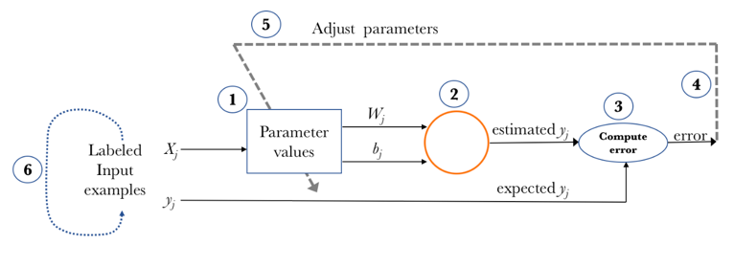
Training The neural network
Torres (2018) described the process as the following:
B) Once the loss has been calculated, this information is propagated backwards. Starting from the output layer, that loss information propagates to all the neurons in the hidden layer that contribute directly to the output. Now that we have spread this information back, we can adjust the weights of connections between neurons.
C) Continue iterating in the previous steps until we consider that we have a good model.
Reference:
J., Torres. (2018, September 21). Learning process of a neural network. Retrieved from https://towardsdatascience.com/how-do-artificial-neural-networks-learn-773e46399fc7

Slide 18
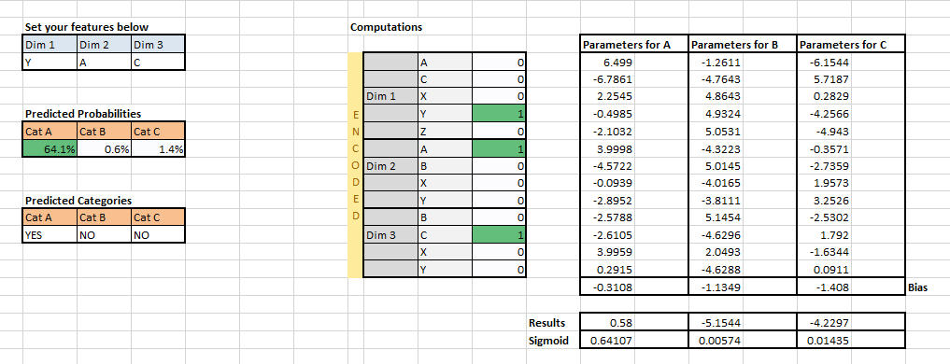
An example

Slide 19
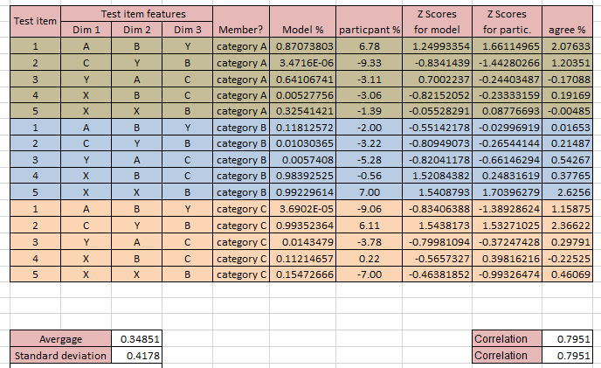
Correlation

Slide 20
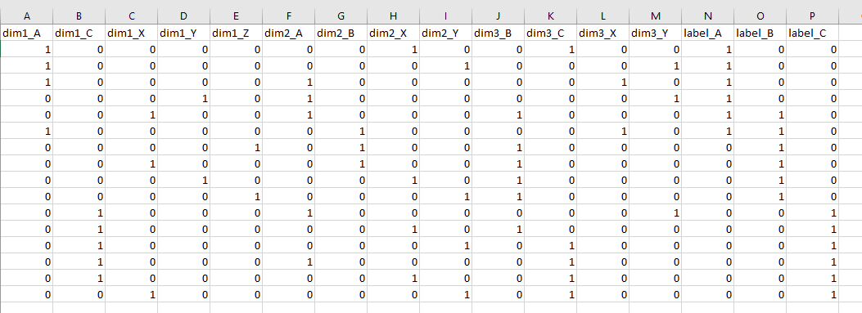
coding
I have used ‘pandas’ package to load, store and do one encoding of the data representing dimensions. I had to encode labels manually.
Encoding is used to represent categorical data in numerical format. This is what it does:
Item № | feature
1 | A
2 | B
3 | A
Item № | feature_A | Feature_B
1 | 1 | 0
2 | 0 | 1
3 | 1 | 0

Slide 21
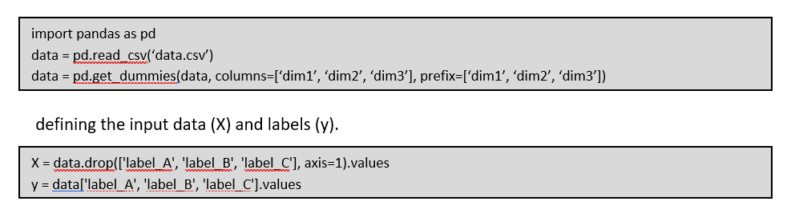
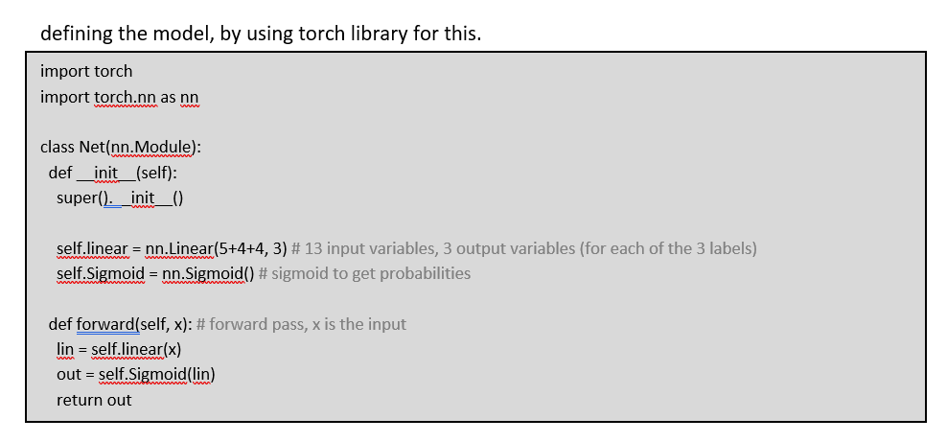
coding

Slide 22
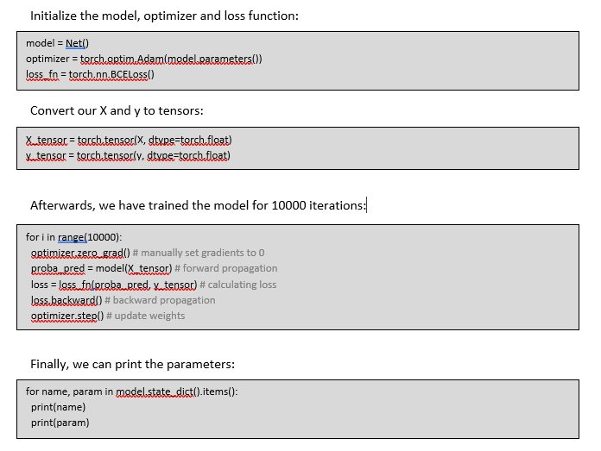
coding

Slide 23
Conclusion
Why did the model fail ?
NN get adjusted to the training data, the more the data the higher the accuracy, it’s all about training.
Weighting attention didn’t work in this model.
For example (YAC), it predicts the probability of this item to be of class A, since it has never seen dim1=Y to be of class C it has strong negative weight -6.15, and it has seen dim3=C for class C, so it has positive weight 1.79.

Slide 24
A SUGGESTION
A research (Categorization by a connectionist network.), Shanks (1991) Said:
Three experiments tested a simple connectionist network approach to human categorization. The specific network considered consists of a layer of input nodes, each representing a feature of the exemplar to be categorized, connected in parallel to a layer of output nodes representing the categories. Learning to categorize examplars consists of adjusting the weights in the network so as to increase the probability of making correct categorizations; weight changes are determined by the R. A. Rescorla and A. R. Wagner (1972) learning rule. The experiments used a simulated medical diagnosis procedure in which Ss have to decide which disease (the category) each of a series of patients is suffering from on the basis of the patients' symptoms (the features). After a series of trials, the Ss rated the extent to which particular symptoms were associated with particular diseases. It is shown that a process of selective learning occurs in this categorization task and that selection depends on the relative predictiveness of the symptom for the disease. Such effects parallel results found in animal conditioning experiments and are readily reproduced by the connectionist network model. Results are discussed in terms of a variety of traditional theories of categorization.
Reference:
Shanks, D. R. (1991). Categorization by a connectionist network. Journal of Experimental Psychology: Learning, Memory, and Cognition, 17(3), 433-443. http://dx.doi.org/10.1037/0278-7393.17.3.433

Slide 25
Thank you!

